Slide 1


ClassPoint Whiteboard Background Examples

Slide 2
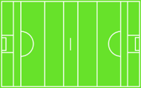

Slide 3
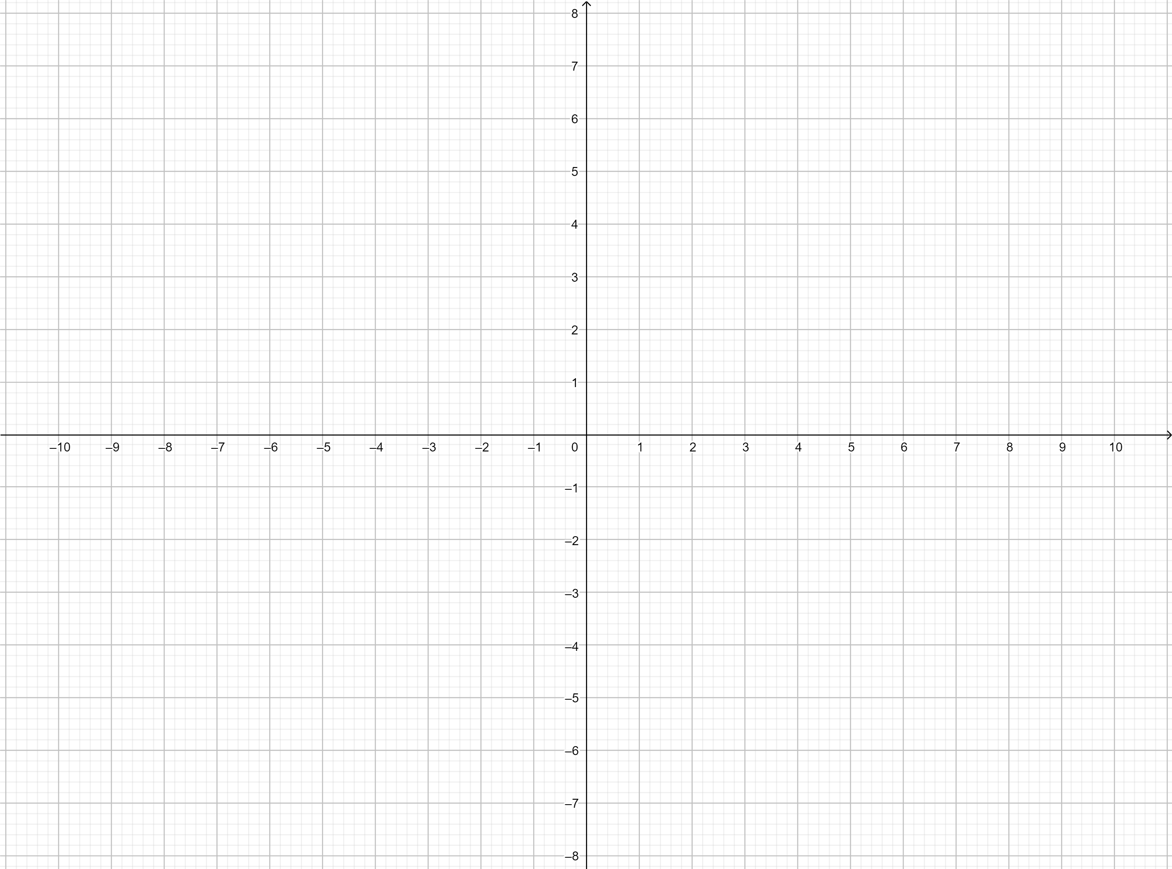

Slide 4
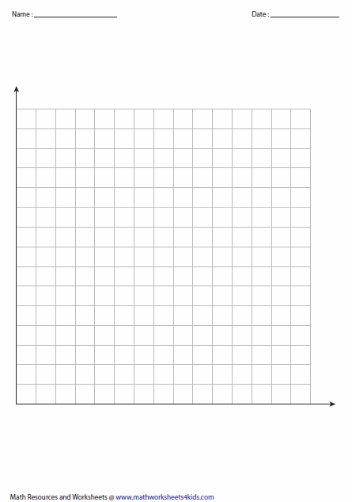

Slide 5
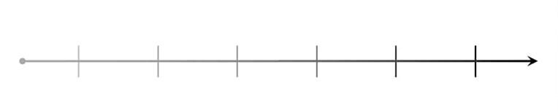

Slide 6
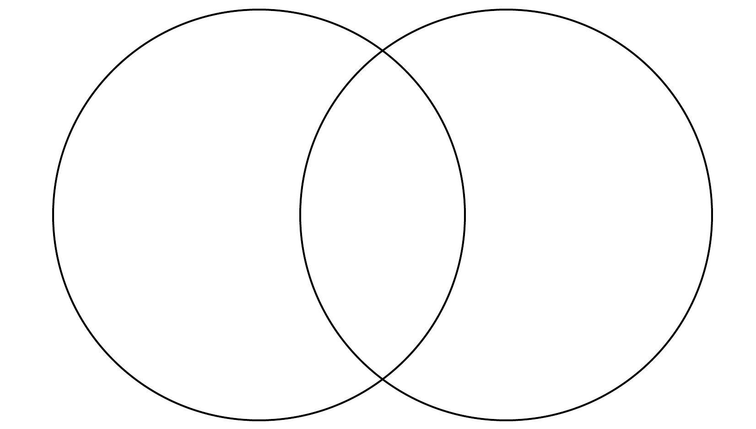

Slide 8
Know | Want to Know | Learned

Slide 9
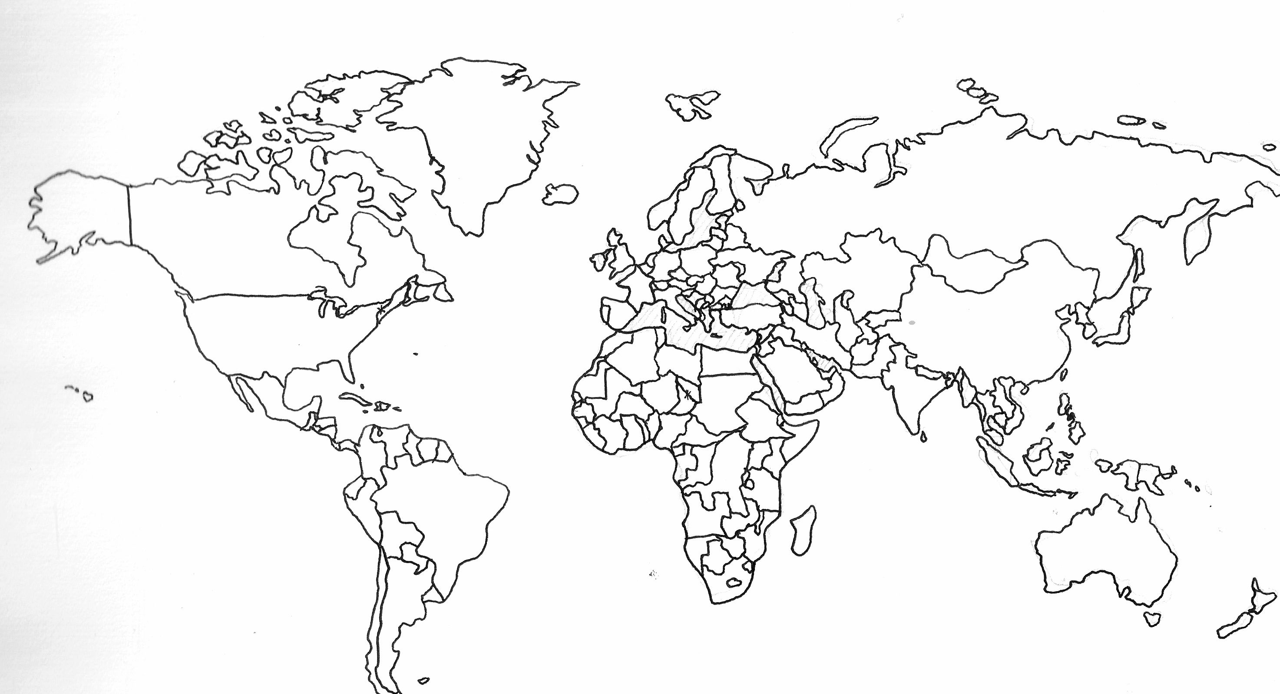

Slide 10


Slide 11


Slide 12


Slide 13


Slide 14


Slide 15


