Slide 2
RECOMMENDED
How to Use This Template (Version A):
Download ClassPoint for free.
Fill in the team members’ names, survey questions and answers in the respective slides.
Choose from a wide selection of ClassPoint’s interactive quiz buttons at your PowerPoint ribbon and add them to your PowerPoint slides. (We recommend using Word Cloud and Fill in the Blanks for Family Feud
Enter slideshow mode to start playing. To start the quiz, click on ClassPoint’s quiz buttons. Invite participants to join using www.classpoint.app.
Reveal the answers one by one using ClassPoint’s Draggable Objects.

Slide 3
To gamify your Family Feud game:
Once you have downloaded ClassPoint and signed in, go to Class List at your PPT ribbon.
Add the participants’ names/teams’ names.
Start the game by allowing the contestants to interact with you using ClassPoint quiz buttons.
Award stars for each round by going to “My Classes” or “Name Picker” tab at the ClassPoint toolbar during Slideshow mode.
Access the leaderboard at the ClassPoint toolbar during Slideshow mode.
Use the Timer feature at the ClassPoint toolbar during the “Fast Money” round!
Leaderboard
Timer
Name Picker

Slide 4
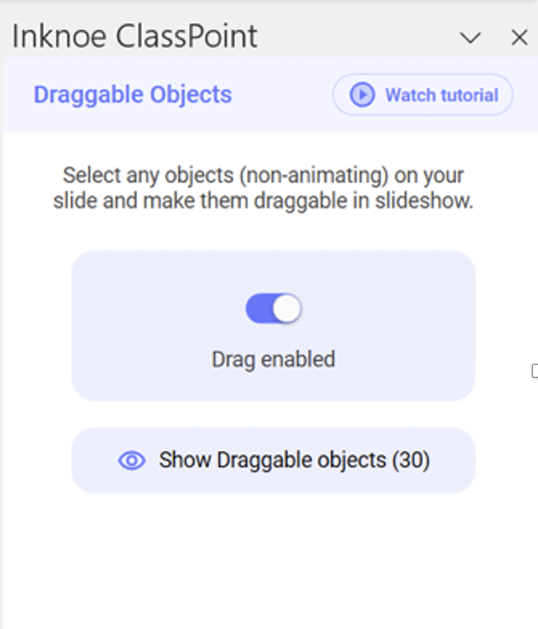
RECOMMENDED
Revealing the Answers (Version A):
We recommend you use ClassPoint’s Draggable Objects to reveal the answers for easy set up and having full control to the slides.
First download ClassPoint for free.
Click “Draggable Objects” on your PowerPoint ribbon.
Add rectangle boxes on top of each answer option.
Select all the rectangle boxes used to cover the answer options
and click “Drag enabled” on the side panel.
To drag and reveal the answers: Enter slideshow mode and click on the Draggable Objects icon at the ClassPoint toolbar to start dragging and revealing the answers underneath!

Slide 5
How to Use This Template (Version B):
Fill in the team members’ names, survey questions and answers in the respective slides.
Start playing with the host/moderator reading out the question prompts.
Participants are invited to respond verbally to the prompts.
Host/moderator/scorekeeper to manually add the scores to the score board in Slide #

Slide 6
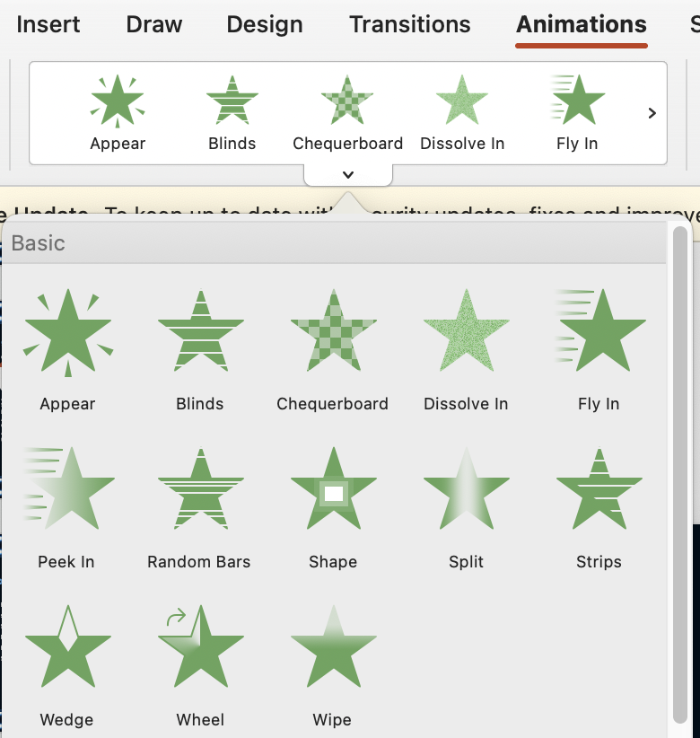
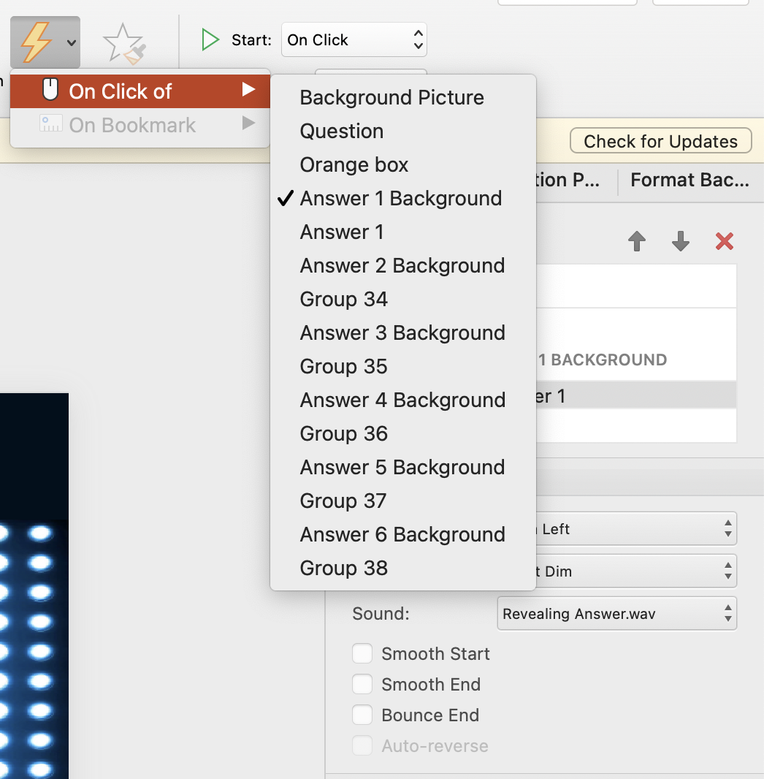
Revealing the Answers (Version B):
You can also use PowerPoint animations to reveal the answers.
Add a rectangular box underneath each answer option.
Select the answer and set the animation
effect you like (for instance, “fly in”).
Set the trigger to “on click of” the
rectangular box underneath the answer option.
Pro tip: rename each element
on the Selection Pane to help
you identify which shape to set
as the “trigger”.

Slide 7
Family 1
Family 2
Name 1
Name 1
Name 2
Name 2
Name 3
Name 3
Name 4
Name 4
Name 5
Name 5

Slide 9
Reveal Answers Using ClassPoint’s
Draggable Objects
Question
Name
VS
Name
Drag to reveal
answers in Slide Show mode
Answer 1
Answer 4
50
5
Answer 2
Answer 5
30
3
Answer 3
Answer 6
10
2

Slide 10
REGULAR ROUNDS

Slide 11
Reveal Answers Using ClassPoint’s
Draggable Objects
Question
Drag to reveal
answers in Slide Show mode
Answer 1
Answer 4
50
5
Answer 2
Answer 5
30
3
Answer 3
Answer 6
10
2

Slide 12
Reveal Answers Using ClassPoint’s
Draggable Objects
Question
Drag to reveal
answers in Slide Show mode
Answer 1
Answer 4
50
5
Answer 2
Answer 5
30
3
Answer 3
Answer 6
10
2

Slide 13
Reveal Answers Using ClassPoint’s
Draggable Objects
Question
Drag to reveal
answers in Slide Show mode
Answer 1
Answer 4
50
5
Answer 2
Answer 5
30
3
Answer 3
Answer 6
10
2

Slide 14
Reveal Answers Using ClassPoint’s
Draggable Objects
Question
Drag to reveal
answers in Slide Show mode
Answer 1
Answer 4
50
5
Answer 2
Answer 5
30
3
Answer 3
Answer 6
10
2

Slide 15
FAST MONEY
FAST MONEY
FAST MONEY
Question

Slide 16
Reveal Answers Using ClassPoint’s
Draggable Objects
Family 1
Drag to reveal
answers in Slide Show mode
Answer 1
Answer 4
50
5
Answer 2
Answer 5
30
3
Answer 3
Answer 6
10
2

Slide 17
Reveal Answers Using ClassPoint’s
Draggable Objects
Family 1
Drag to reveal
answers in Slide Show mode
Answer 1
Answer 4
50
5
Answer 2
Answer 5
30
3
Answer 3
Answer 6
10
2

Slide 18
Winning Team:
NAME

Slide 19
Family 1
Family 2
Name 1
Name 1
Name 2
Name 2
Name 3
Name 3
Name 4
Name 4
Name 5
Name 5

Slide 21
Reveal Answers Using Animation
Question
Name
VS
Name
Answer 1
Answer 4
50
5
Answer 2
Answer 5
30
3
Answer 3
Answer 6
10
2

Slide 22
REGULAR ROUNDS

Slide 23
Reveal Answers Using Animation
Question
Answer 1
Answer 4
50
5
Answer 2
Answer 5
30
3
Answer 3
Answer 6
10
2

Slide 24
Reveal Answers Using Animation
Question
Answer 1
Answer 4
50
5
Answer 2
Answer 5
30
3
Answer 3
Answer 6
10
2

Slide 25
Reveal Answers Using Animation
Question
Answer 1
Answer 4
50
5
Answer 2
Answer 5
30
3
Answer 3
Answer 6
10
2

Slide 26
Reveal Answers Using Animation
Question
Answer 1
Answer 4
50
5
Answer 2
Answer 5
30
3
Answer 3
Answer 6
10
2

Slide 27
FAST MONEY
FAST MONEY
FAST MONEY

Slide 28
FAST MONEY
FAST MONEY
FAST MONEY
Question

Slide 29
Reveal Answers Using Animation
Family 1
Answer 1
Answer 4
50
5
Answer 2
Answer 5
30
3
Answer 3
Answer 6
10
2

Slide 30
Reveal Answers Using Animation
Family 2
Answer 1
Answer 4
50
5
Answer 2
Answer 5
30
3
Answer 3
Answer 6
10
2

Slide 31
Winning Team:
NAME

Slide 32
Resources
Run an Interactive Quiz
Reveal Leaderboard
Award Stars

