Slide 1


Increase Staff Engagements in Year-End Meetings
HERE IS WHERE YOUR PRESENTATION BEGINS

Slide 2

Guess Who?
Upload your baby photo (make sure no one sees yours as you upload!)

Slide 3

Upload an image which best expresses how this year had been for you
(challenges, successes…)

Slide 4


Make a guess…
What are the top FIVE achievements of the English Department this year?
Submit your responses as a team

Slide 5

Project timelines
Jan
Feb
Mar
Apr
Key tasks to be completed
Key tasks to be completed
Key tasks to be completed
Key tasks to be completed
Staff I/C
Staff I/C
Staff I/C
Staff I/C

Slide 6
Project timelines
May
Jun
Jul
Aug
Key tasks to be completed
Key tasks to be completed
Key tasks to be completed
Key tasks to be completed
Staff I/C
Staff I/C
Staff I/C
Staff I/C

Slide 7
Project timelines
Sep
Oct
Nov
Dec
Key tasks to be completed
Key tasks to be completed
Key tasks to be completed
Key tasks to be completed
Staff I/C
Staff I/C
Staff I/C
Staff I/C

Slide 8

Having heard the plans and impending developments for 2022, what do you look forward to/what are some challenges you foresee?

Slide 9


Now that we have greater clarity of the organisational direction and upcoming projects, how do you feel as we approach 2022?

Slide 10
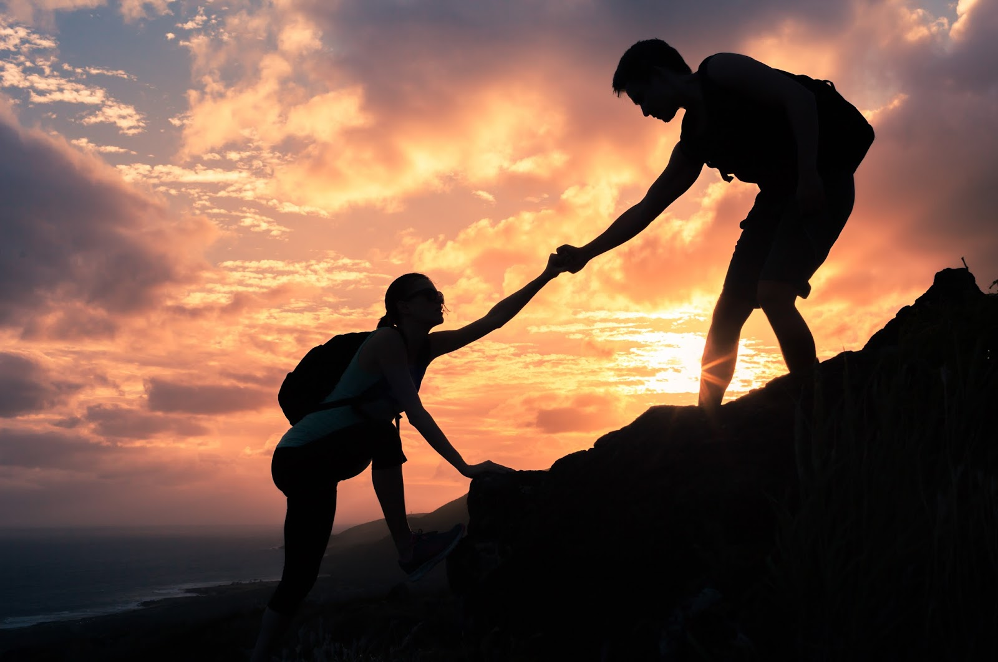
How would you like to be supported by the organisation to help you excel in 2022?

Slide 11
Monthly Calendar Whiteboard Backgrounds

Slide 12
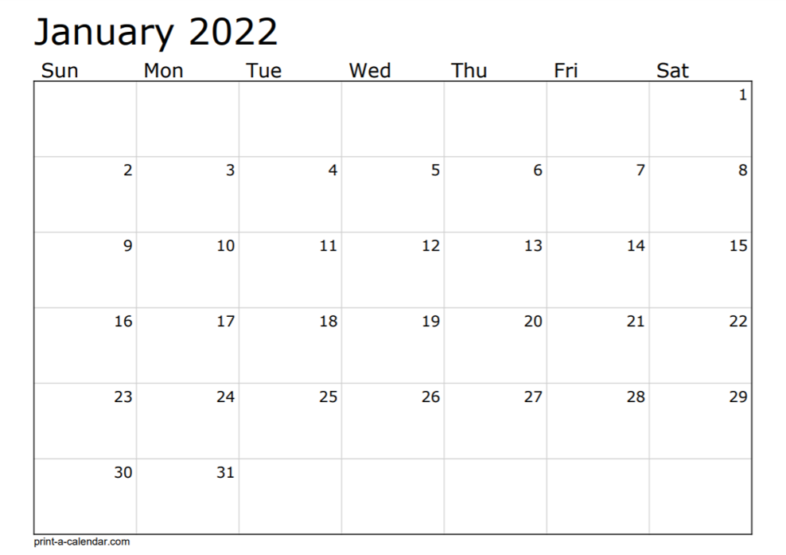

Slide 13
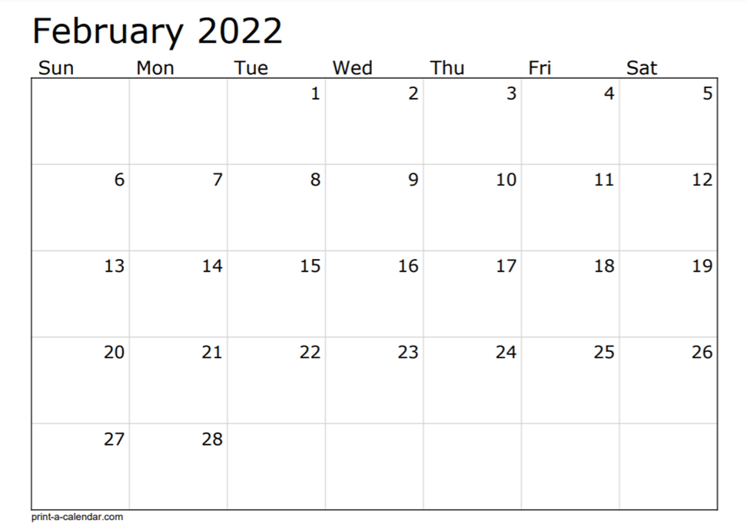

Slide 14
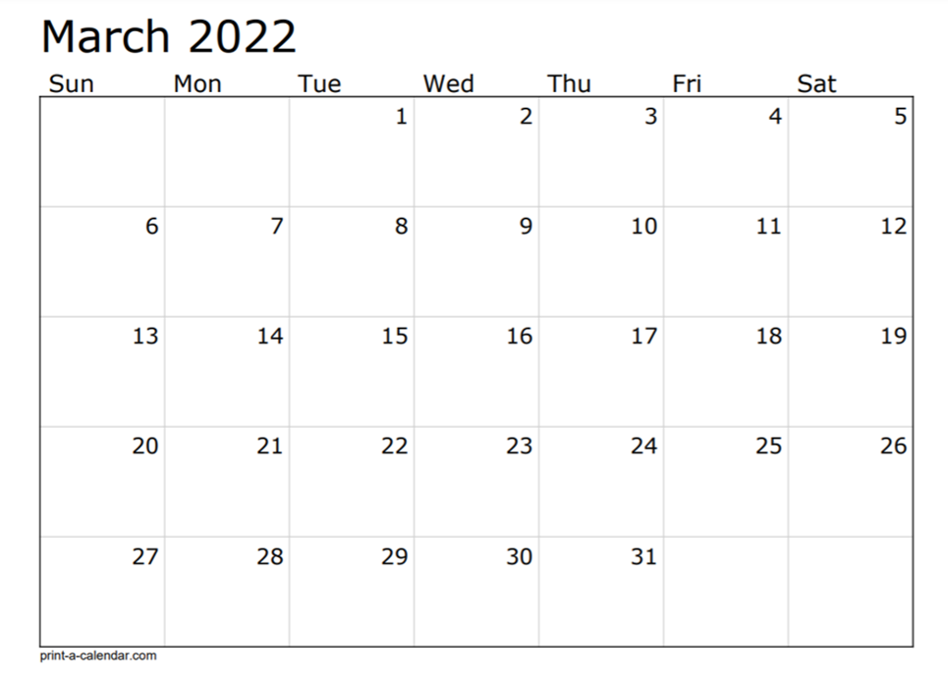

Slide 15
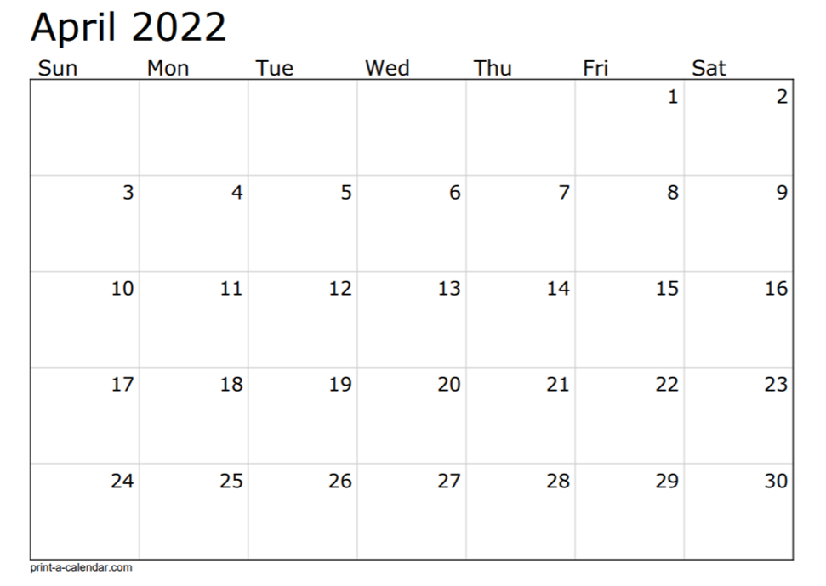

Slide 16
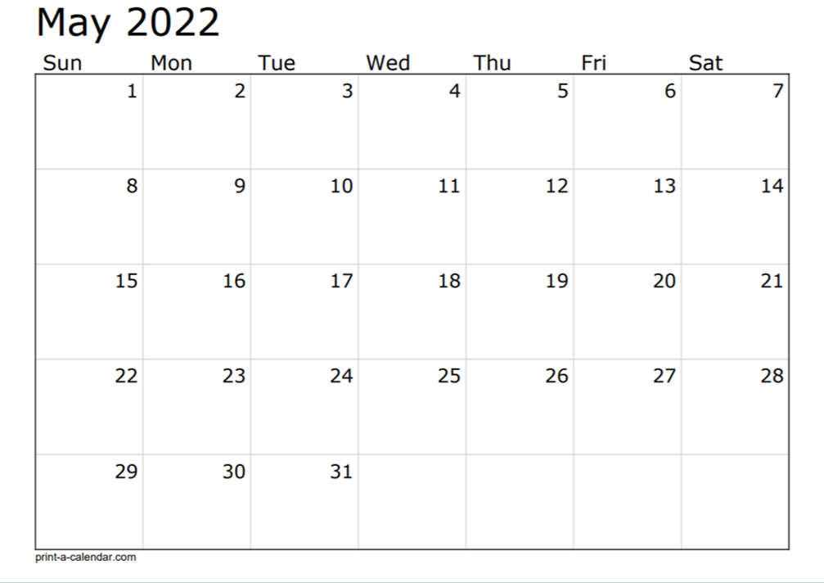

Slide 17
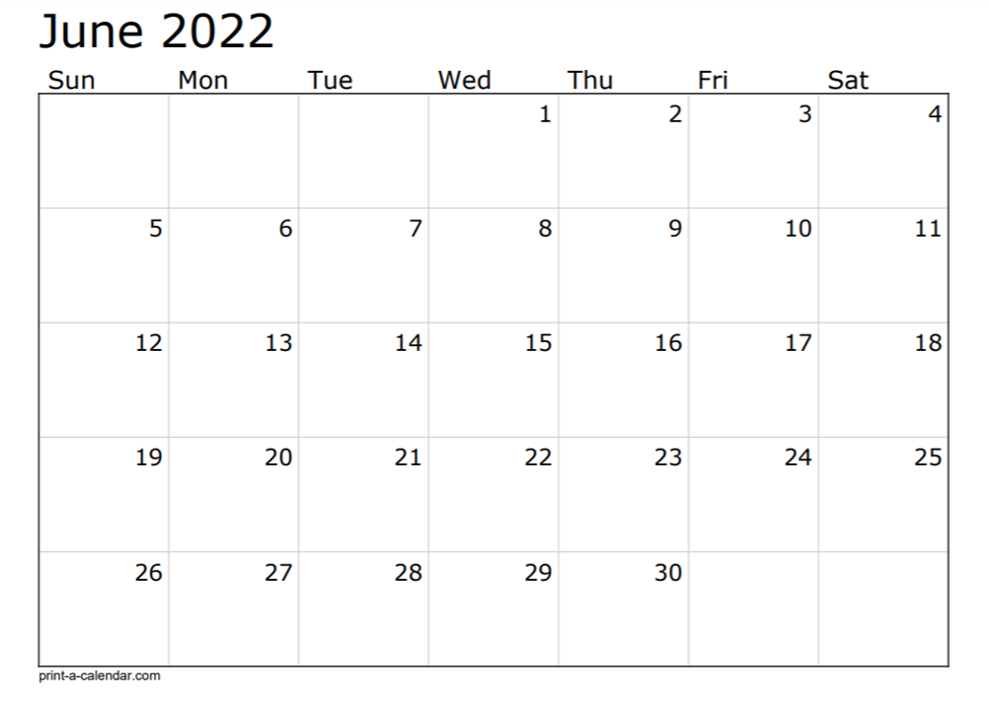

Slide 18
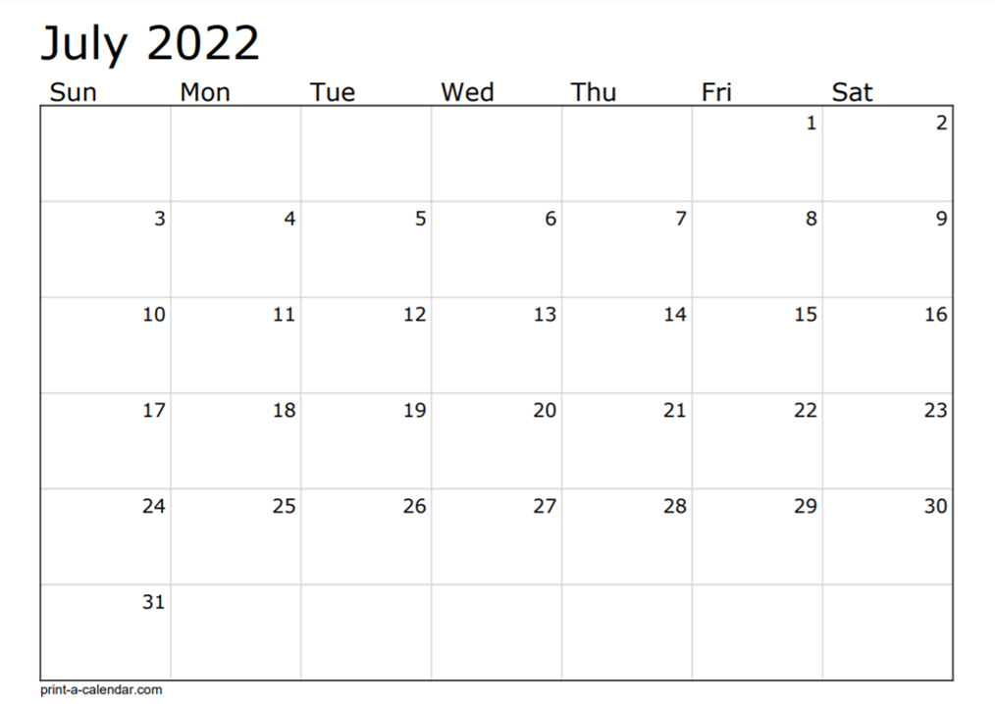

Slide 19
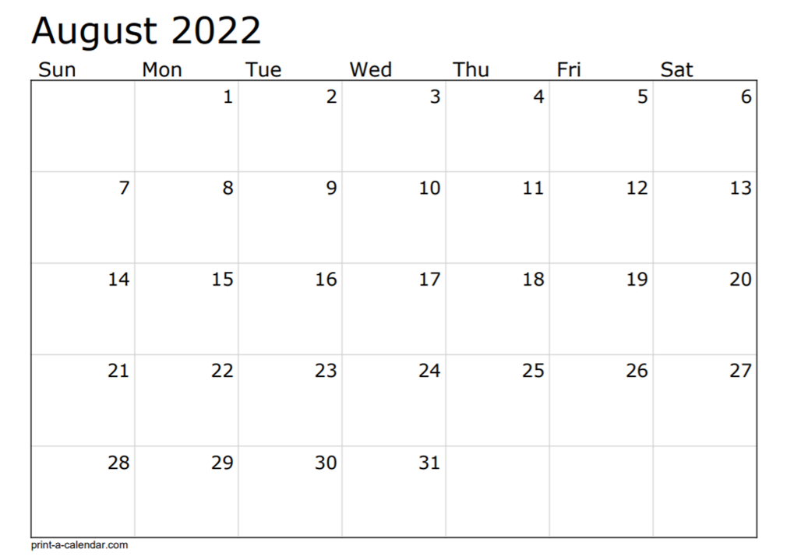

Slide 20
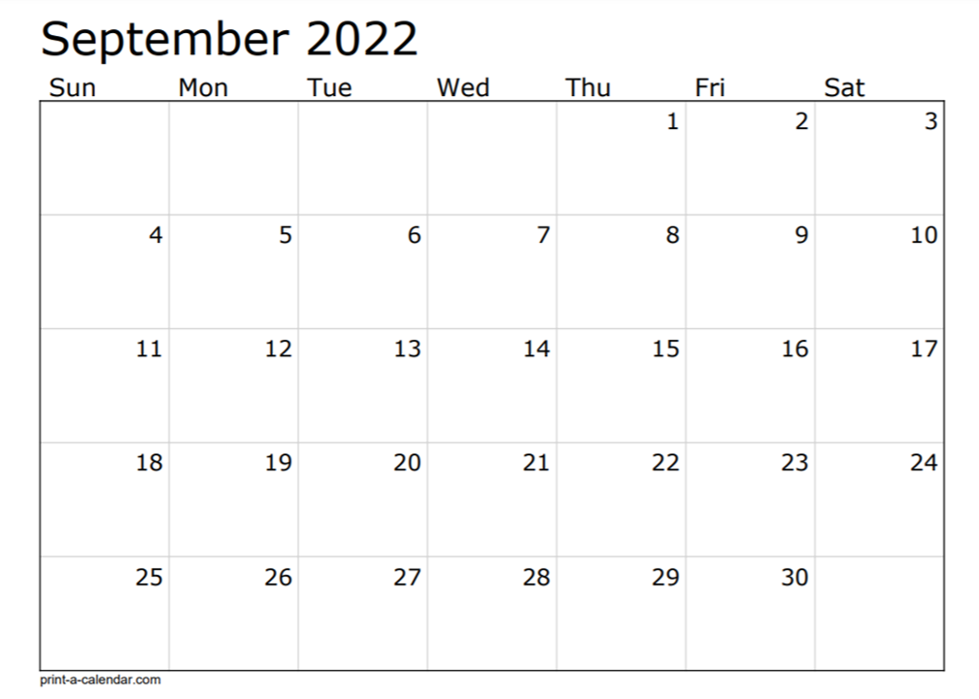

Slide 21
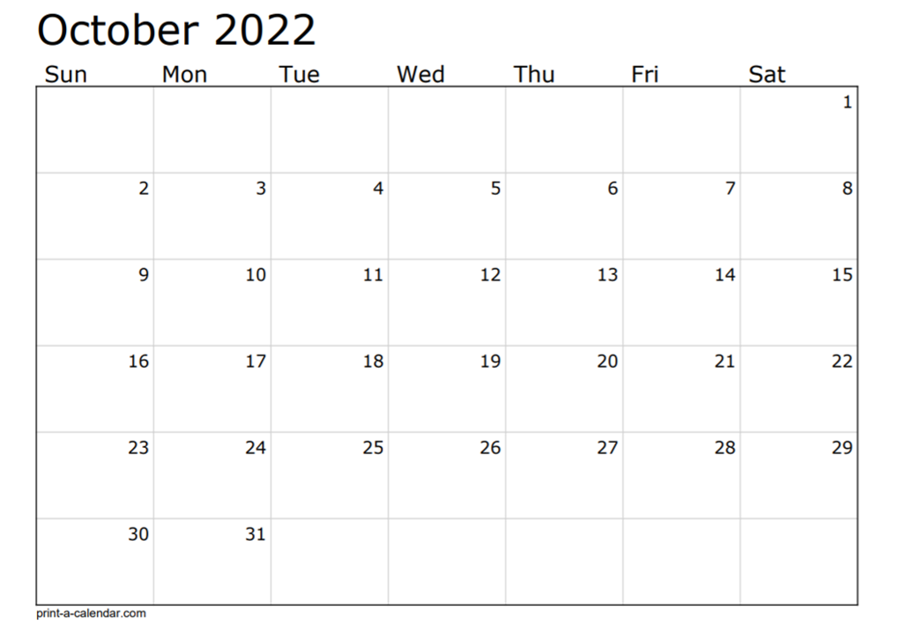

Slide 22
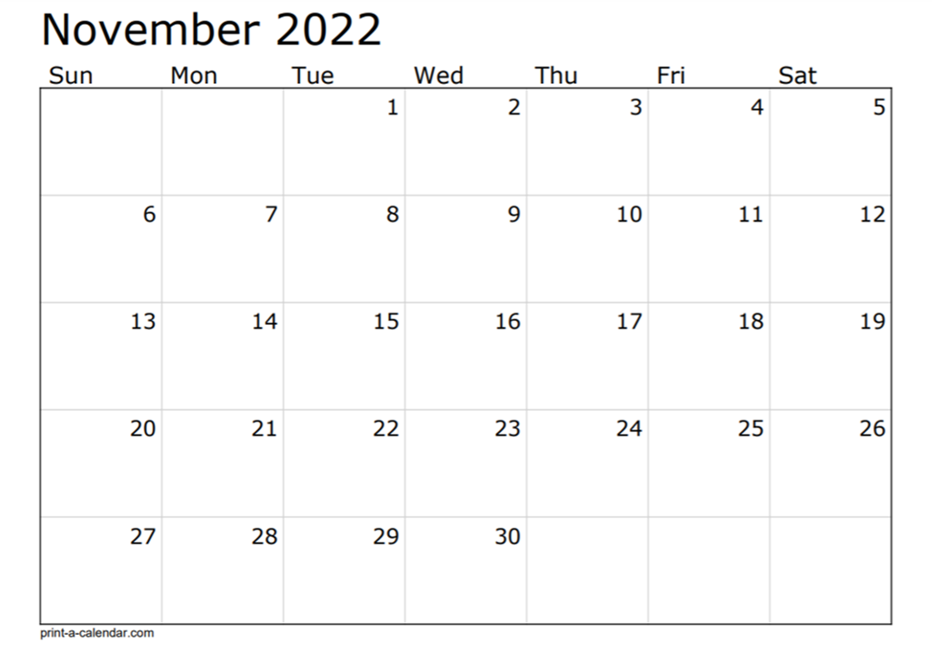

Slide 23
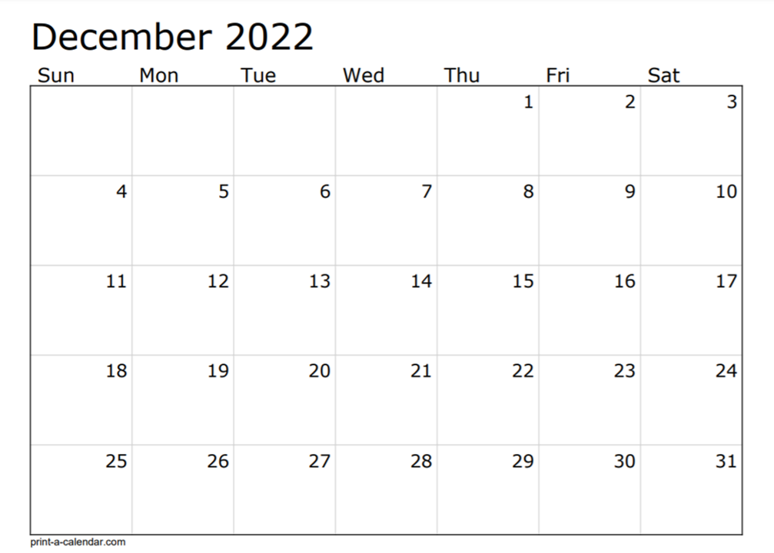

Slide 24
Project Timeline Whiteboard Backgrounds

Slide 25
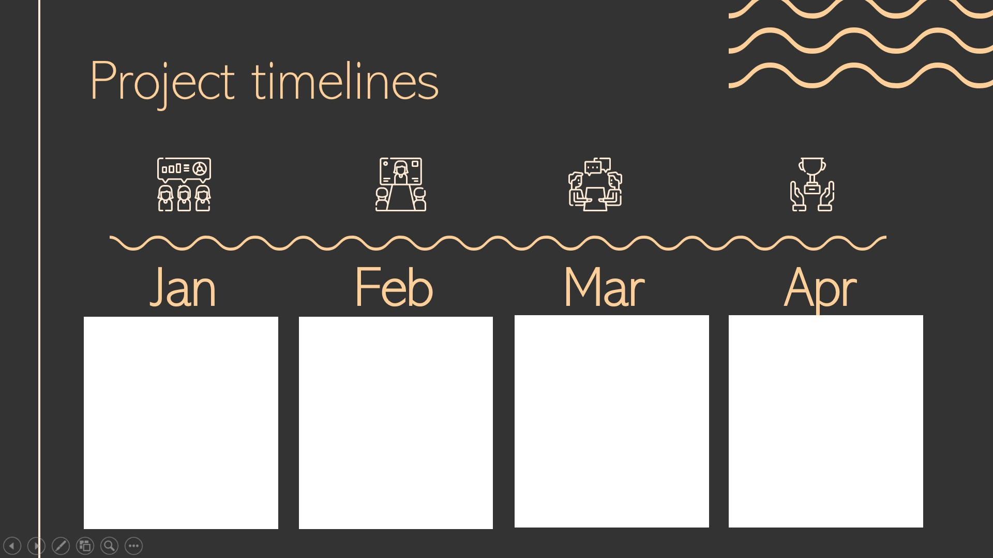

Slide 26
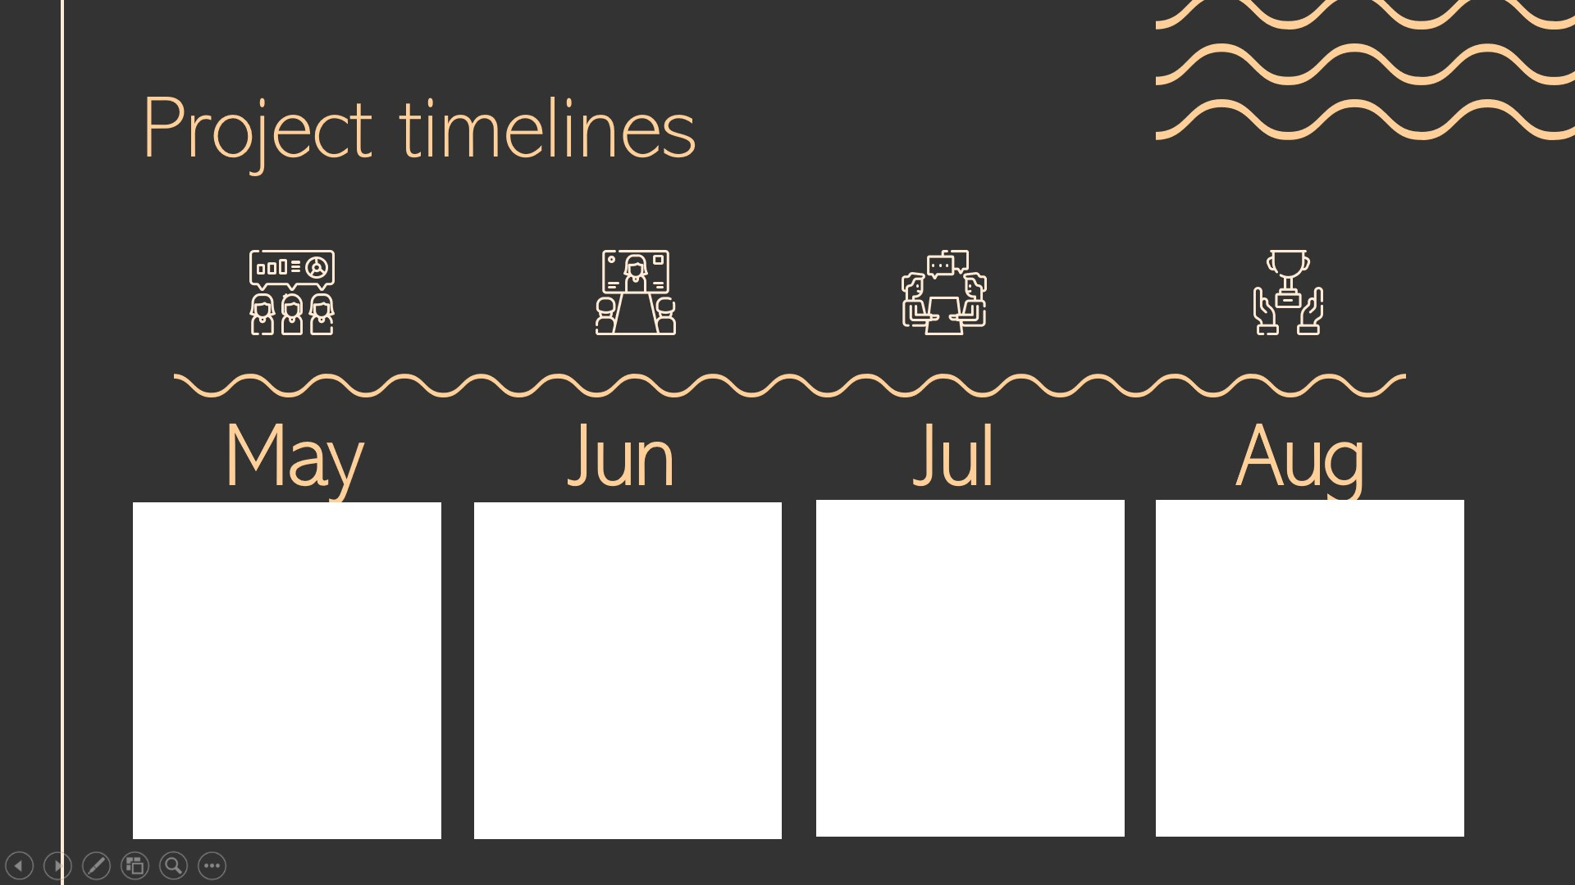

Slide 27
