Slide 1
JEOPARDY
JEOPARDY
JEOPARDY
POWERPOINT
TEMPLATE
POWERPOINT
TEMPLATE

Slide 2
How to Use This Template:
Filling In Clues
You can either fill in the clues in the individual slides associated with the Jeopardy categories and point values.
Or fill in the clues in behind the individual point values on the game board.
Daily Double
There is 1 Daily Double hidden in the Jeopardy game board, and 2 Daily Doubles hidden in the Double Jeopardy game board (we have highlighted them). Feel free to change the positions of the Daily Doubles on the game boards.
Double Jeopardy and Final Jeopardy
If you are not playing Double Jeopardy and Final Jeopardy, feel free to ignore the respective game board and slides.
*We have also included sample clues and questions for the first Jeopardy round so you can start playing straightaway!

Slide 3
To use ClassPoint’s Draggable Objects:
*If you have created your clue behind the point value on the same slide as the game board, you can utilize ClassPoint’s Draggable Objects to reveal the clues behind each point value during the game.
To use ClassPoint’s Draggable Objects to set up the game board :
Download ClassPoint for free.
Click “Draggable Objects” on your PowerPoint ribbon.
Select the objects you would like to turn into Draggable Objects and click
“Drag enabled” on the side panel.
*All the point values in this template has already been made as Draggable Objects for your convenience.

Slide 4
How to Play:
Revealing Clues
There are 2 ways you can reveal the clues and play:
If you added the clues in the game board and applied Draggable Objects (read Slide #3 on how to apply Draggable Objects), you can reveal the clue by entering slideshow mode and clicking on the Draggable Objects icon at the ClassPoint toolbar.
Alternatively, if you added the clues in separate slides in this deck, you can reveal the clues simply by clicking on the point values in the game board (they are already hyperlinked to their respective clue slides).
Receiving Responses
You can either receive responses manually (verbal responses/have contestants type their responses in the PowerPoint deck), or use ClassPoint’s interactive quiz buttons. (Refer Slide #5 for an in-depth tutorial).
Scoring
You can either create a manual score board to keep track of the contestants’ scores, or use ClassPoint’s gamification features for points rewarding and leaderboard. (Refer Slide #6 for more details).

Slide 5
To play using ClassPoint interactive quiz buttons:
Download ClassPoint for free.
Choose from a wide selection of ClassPoint interactive quiz buttons at your PowerPoint ribbon and add them to your PowerPoint clue slides. (We recommend using Short Answer for Jeopardy games!)
Enter slideshow mode to start playing. To start the quiz, click on ClassPoint’s quiz buttons. Invite participants to join on their devices at www.classpoint.app to start collecting responses!

Slide 6
To gamify THE game with ClassPoint’s gamification:
Once you have downloaded ClassPoint and signed in, go to Class List at your PPT ribbon.
Add the participants’ names/teams’ names.
Award Points – During each Jeopardy game round, award and deduct stars from the contestants/contesting teams by going to “My Classes” or “Name Picker” tab at the ClassPoint toolbar during PowerPoint Slideshow mode.
Leaderboard – You can access the leaderboard feature at the ClassPoint toolbar during PowerPoint Slideshow mode to keep track of the scores during the game.
Leaderboard
Name Picker

Slide 7
GAME RULES
Team Formation (optional): Participants are divided into 3 teams.
Choosing Clues: Each team takes turns picking clues from the game board. The host reveals the question.
Getting It Right: A team that answers correctly scores points.
Getting It Wrong: If a team gets it wrong, they lose those points.
Not Answering: A team can choose to not answer if they are not sure of the correct response. No points are gained or lost.
Daily Double: If a team snags one, they can wager any or all of their current
points on the line before even seeing the clue. If they win, they score big; but if not,
they lose all the points they bet.
Double Jeopardy: In Double Jeopardy, points go up but the game's still the same.
There are 2 "Double Jeopardy" clues where teams can bet.
Final Jeopardy: The final clue of the game. Teams wager their points and compete under a time limit.
Winner: The team with the highest score at the end of the game wins!

Slide 8
GAME BOARD
Category 1
Category 2
Category 3
Category 4
Category 5
Category 6
$200
Your Clue
Here
Your Clue
Here
Your Clue
Here
Your Clue
Here
Your Clue
Here
Your Clue
Here
$200
$200
$200
$200
$200
$400
$400
$400
$400
$400
$400
Your Clue
Here
Your Clue
Here
Your Clue
Here
Your Clue
Here
Your Clue
Here
Your Clue
Here
Your Clue
Here
Your Clue
Here
Your Clue
Here
$600
Your Clue
Here
Your Clue
Here
Clue
Here
$600
$600
$600
$600
$600
$800
$800
$800
$800
$800
$800
Your Clue
Here
Your Clue
Here
Your Clue
Here
Your Clue
Here
Daily
Double!
Your Clue
Here
$1000
$1000
$1000
$1000
$1000
$1000
Your Clue
Here
Your Clue
Here
Your Clue
Here
Your Clue
Here
Your Clue
Here
Your Clue
Here

Slide 9
ANSWERS (TEMPLATE)
Category 1
Category 2
Category 3
Category 4
Category 5
Category 6
Answer
Here
Answer
Here
Answer
Here
Answer
Here
Answer
Here
Answer
Here
Answer
Here
Answer
Here
Answer
Here
Answer
Here
Answer
Here
Answer
Here
Answer
Here
Answer
Here
Answer
Here
Answer
Here
Answer
Here
Answer
Here
Answer
Here
Answer
Here
Answer
Here
Answer
Here
Answer
Here
Answer
Here
Answer
Here
Answer
Here
Answer
Here
Answer
Here
Answer
Here
Answer
Here

Slide 10
ANSWERS (SAMPLE ROUND)
Category 1
Category 2
Category 3
Category 4
Category 5
Category 6
What is a
Neutron?
What is
Venice?
Who is
Abraham Lincoln?
Who are
The Beatles?
Who is
Usain Bolt?
Who is Robert
Downey Jr.?
What is Penicillin?
What is
Australia?
Who is Archduke
Franz Ferdinand?
What is
Star Wars?
What is
Rugby?
Who is
Adele?
What is the mass-energy equivalence equation?
What is
Sahara Desert?
Who is
King John?
Who is Leonardo da Vinci?
What is the
Super Bowl?
Who is Jennifer Lawrence?
What is the law of conservation of energy?
What is Nile
River?
What is the Battle of Hastings?
What is Games of Thrones?
Who is
Muhammad Ali?
Who is Leonardo DiCaprio?
What is Earth’s
Tectonic plates?
What is the Pharos of Alexandria?
What is the Great Pyramid of Giza?
What is
Pokemon?
What is
The Masters?
Who is
Oprah Winfrey?

Slide 11
Category 1 • $200
This fundamental particle has no electric charge and plays a crucial role in binding atomic nuclei together.

Slide 12
Category 1 • $400
Discovered in 1928, this antibiotic revolutionized medicine by effectively treating bacterial infections.

Slide 13
Category 1 • $600
This famous equation, E=mc², relates mass and energy and is a cornerstone of modern physics.

Slide 14
Category 1 • $800
In physics, this fundamental principle states that energy cannot be created or destroyed, only transformed.

Slide 15
Category 1 • $1000
These protective outer layers of the Earth are divided into lithosphere, asthenosphere, and mesosphere.

Slide 16
Category 2 • $200
This European capital is often referred to as the "City of Canals" and is famous for its intricate waterway system.

Slide 17
Category 2 • $400
The Great Barrier Reef, the world's largest coral reef system, is located in this country's waters.

Slide 18
Category 2 • $600
The world's largest desert, it covers much of northern Africa and is known for its vast sand dunes.

Slide 19
Category 2 • $800
This Asian river is the longest in the world, flowing through several countries including China and Egypt.

Slide 20
Category 2 • $1000
This ancient city, one of the Seven Wonders of the Ancient World, was situated along the Mediterranean coast of Egypt.

Slide 21
Category 3 • $200
This American president issued the Emancipation Proclamation in 1863, freeing slaves in Confederate states.

Slide 22
Category 3 • $400
The assassination of this Archduke of Austria-Hungary in 1914 triggered the start of World War I.

Slide 23
Category 3• $600
The Magna Carta, signed in 1215, is a historic document that limited the powers of this English king.

Slide 24
Category 3 • $800
In 1066, this historic event led to William the Conqueror's successful invasion of England.

Slide 25
Category 3 • $1000
The construction of this ancient wonder, completed around 2560 BCE, is still a subject of debate among historians.

Slide 26
Category 4 • $200
This iconic British rock band released the album "Sgt. Pepper's Lonely Hearts Club Band" in 1967.

Slide 27
Category 4 • $400
"May the Force be with you" is a famous catchphrase from this epic space opera film series.

Slide 28
Category 4• $600
This artist's "Mona Lisa" and "The Last Supper" are among the most famous works in the history of art.

Slide 29
Category 4 • $800
This American television series, set in the fictional realm of Westeros, gained massive popularity for its complex characters and political intrigue.

Slide 30
Category 4 • $1000
This pop culture phenomenon, created by Satoshi Tajiri, involves capturing, training, and battling creatures trapped in magical balls.

Slide 31
Category 5 • $200
This Jamaican sprinter, often referred to as the fastest man alive, holds multiple world records in the 100m and 200m races.

Slide 32
Category 5 • $400
This sport, known for its scrums, rucks, and lineouts, is a popular form of football played internationally.

Slide 33
Category 5• $600
In American football, this annual championship game is played between the winners of the National Football Conference (NFC) and the American Football Conference (AFC).

Slide 34
Category 5 • $800
The "Ali Shuffle" and the "Rumble in the Jungle" are associated with this legendary heavyweight boxer.

Slide 35
Category 5 • $1000
This major golf tournament is held annually at Augusta National Golf Club and is known for its green jacket prize.

Slide 36
Category 6 • $200
This actor is known for portraying Tony Stark in the Marvel Cinematic Universe and famously saying, "I am Iron Man."

Slide 37
Category 6 • $400
With hits like "Hello" and "Rolling in the Deep," this British singer is renowned for her soulful voice.

Slide 38
Category 6• $600
This actress starred as Katniss Everdeen in "The Hunger Games" film series and earned an Academy Award for her role in "Silver Linings Playbook."

Slide 39
Category 6 • $800
Known for his role as Jack Dawson in "Titanic," this actor is also a passionate environmental activist.

Slide 40
Category 6 • $1000
This talk show host, philanthropist, and actress is known for her long-running TV program and influential contributions to various causes.

Slide 41
2
DAILY
DOUBLE
DAILY
DOUBLE
DAILY
DOUBLE

Slide 42
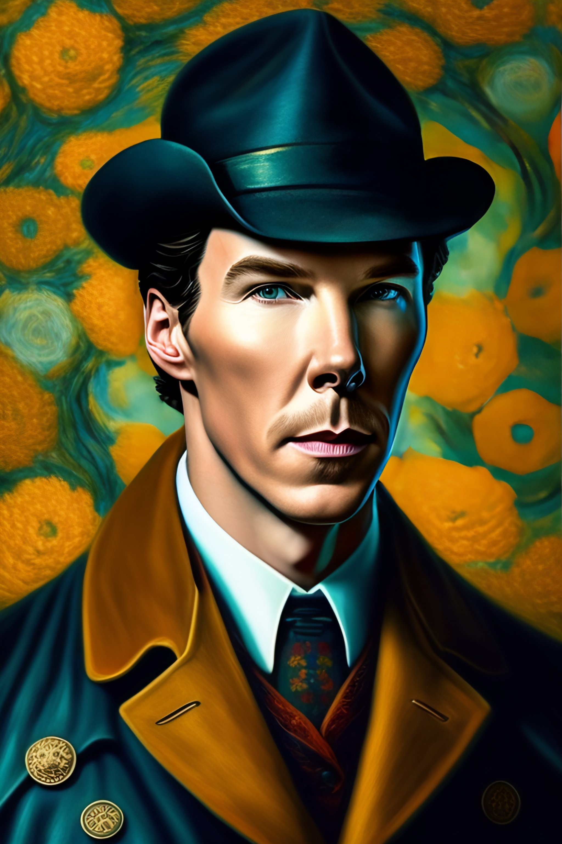
Daily Double!
[Points]
This iconic detective, known
for his brilliant deductive skills
and pipe-smoking, resides at
221B Baker Street.

Slide 43
DOUBLE JEOPARDY!
Category 1
Category 2
Category 3
Category 4
Category 5
Category 6
Your Clue
Here
Your Clue
Here
Daily
Double
Your Clue
Here
$400
$400
$400
$400
$400
$400
Your Clue
Here
Your Clue
Here
$800
$800
$800
$800
$800
$800
Your Clue
Here
Your Clue
Here
Your Clue
Here
Your Clue
Here
Your Clue
Here
Your Clue
Here
$1200
Your Clue
Here
Your Clue
Here
Daily
Double
Your Clue
Here
Your Clue
Here
Your Clue
Here
$1200
$1200
$1200
$1200
$1200
$1600
$1600
$1600
$1600
$1600
$1600
Your Clue
Here
Your Clue
Here
Your Clue
Here
Your Clue
Here
Your Clue
Here
Your Clue
Here
$2000
$2000
$2000
$2000
$2000
$2000
Your Clue
Here
Your Clue
Here
Your Clue
Here
Your Clue
Here
Your Clue
Here
Your Clue
Here

Slide 44
ANSWERS
Category 1
Category 2
Category 3
Category 4
Category 5
Category 6
Answer
Here
Answer
Here
Answer
Here
Answer
Here
Answer
Here
Answer
Here
Answer
Here
Answer
Here
Answer
Here
Answer
Here
Answer
Here
Answer
Here
Answer
Here
Answer
Here
Answer
Here
Answer
Here
Answer
Here
Answer
Here
Answer
Here
Answer
Here
Answer
Here
Answer
Here
Answer
Here
Answer
Here
Answer
Here
Answer
Here
Answer
Here
Answer
Here
Answer
Here
Answer
Here

Slide 45
Category 1 • $400
Clue
Here

Slide 46
Category 1 • $800
Clue
Here

Slide 47
Category 1 • $1200
Clue
Here

Slide 48
Category 1 • $1600
Clue
Here

Slide 49
Category 1 • $2000
Clue
Here

Slide 50
Category 2 • $400
Clue
Here

Slide 51
Category 2 • $800
Clue
Here

Slide 52
Category 2 • $1200
Clue
Here

Slide 53
Category 2 • $1600
Clue
Here

Slide 54
Category 2 • $2000
Clue
Here

Slide 55
Category 3 • $400
Clue
Here

Slide 56
Category 3 • $800
Clue
Here

Slide 57
Category 3 • $1200
Clue
Here

Slide 58
Category 3 • $1600
Clue
Here

Slide 59
Category 3 • $2000
Clue
Here

Slide 60
Category 4 • $400
Clue
Here

Slide 61
Category 4 • $800
Clue
Here

Slide 62
Category 4 • $1200
Clue
Here

Slide 63
Category 4 • $1600
Clue
Here

Slide 64
Category 4 • $2000
Clue
Here

Slide 65
Category 5 • $400
Clue
Here

Slide 66
Category 5 • $800
Clue
Here

Slide 67
Category 5 • $1200
Clue
Here

Slide 68
Category 5 • $1600
Clue
Here

Slide 69
Category 5 • $2000
Clue
Here

Slide 70
Category 6 • $400
Clue
Here

Slide 71
Category 6 • $800
Clue
Here

Slide 72
Category 6 • $1200
Clue
Here

Slide 73
Category 6 • $1600
Clue
Here

Slide 74
Category 6 • $2000
Clue
Here

Slide 75
2
DAILY
DOUBLE
DAILY
DOUBLE
DAILY
DOUBLE

Slide 76
Daily Double!
[Points]
Clue
Here

Slide 77
Daily Double!
[Points]
Clue
Here

Slide 78
FINAL JEOPARDY!
[Points]
Clue
Here

Slide 79
WINNER:
NAME

Slide 80
Resources
Run an Interactive Quiz/Game
Reveal Leaderboard
Award Stars
Refer here for more ClassPoint tutorials.

Slide 81
Template created by ClassPoint
Connect with Us
Facebook
YouTube
Twitter
Pinterest
Instagram
TikTok
Sign up for free to get ClassPoint here
LinkedIn
support@inknoe.com

