Slide 1
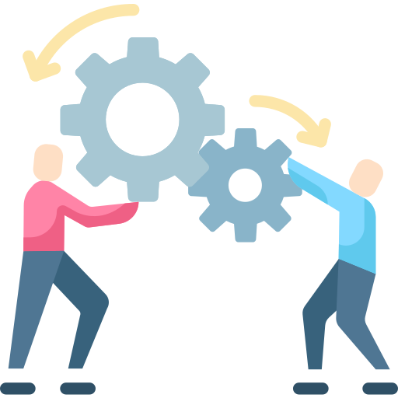
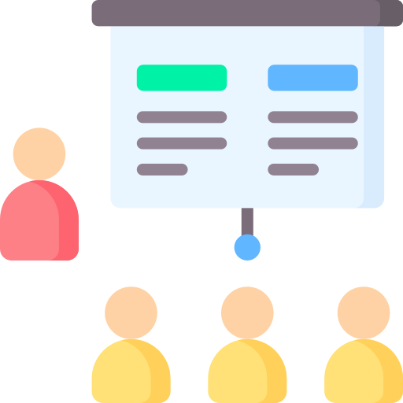
Key Initiatives

Slide 2
Digital Transformation
Modernize and digitize business processes to enhance efficiency, agility, and customer experience.
Implementing cloud technologies, adopting digital collaboration tools, and automating manual processes.

Slide 3
Customer Experience
Improve the overall satisfaction and loyalty of customers by enhancing their experience with products, services, or support.
Implementing a CRM system, launching targeted marketing campaigns, and improving user interfaces.

Slide 4
Product Innovation
Introduce new products or enhance existing ones to stay competitive and meet evolving customer needs.
Conducting market research, investing in research and development, and launching new product features or versions.

Slide 5
Operational Efficiency
Streamline internal processes and reduce operational costs to improve overall business efficiency and profitability.
Implementing lean methodologies, optimizing supply chain processes, and adopting cost-effective technologies.

Slide 6
Employee Training
Invest in the skills and knowledge of the workforce to enhance productivity, job satisfaction, and overall organizational performance.
Offering training programs, creating a learning and development culture, and providing opportunities for skill advancement.

Slide 7
Template created by ClassPoint
Check us out and download for free at www.classpoint.io

