Slide 1
Managing exam stress
Here’s where your presentation begins

Slide 2
What is stress?
Stress is what arises when something you care about is at stake¹

Slide 3
Stress-o-meter
As the exams approach, how stressed are you feeling?
(Feel free to draw how you feel if it’s neither of these)

Slide 4
When may stress be helpful?

Slide 5
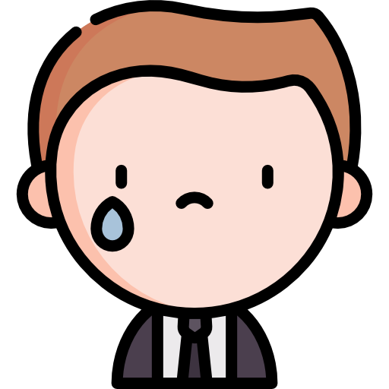
When may stress be unhelpful?

Slide 6
What are the different ways of coping with stress?
Notes:
Image from: <a href="https://www.freepik.com/photos/people">People photo created by freepic.diller - www.freepik.com</a>

Slide 7
From the different ways shared in the previous activity, which one would you most likely adopt?

Slide 8
In what ways would you like others (parents, friends, teachers) help you cope with stress?

Slide 9
Reference
McGonigal, K. (2015). The Upside of Stress. BooksVooks. https://booksvooks.com/nonscrolablepdf/the-upside-of-stress-why-stress-is-good-for-you-and-how-to-get-good-at-it-pdf.html?page=15

