Slide 1

FREE CLASSPOINT TEMPLATE
Math Formative
Assessment
5 quick checks for understanding you can run live in PowerPoint
Check. Adjust. Teach.
Presented by: [Name]
www.classpoint.io

Slide 2


Template
brought to you by

Slide 3
Run this Template
Visit www.classpoint.io
1
Sign up for free
2
Proceed to download
3
www.classpoint.io

Slide 4
Setting up ClassPoint questions
1
Create a question slide
Note to presenter
The quiz slides in this template already have ClassPoint quiz buttons attached!
2
Add a ClassPoint quiz button
3
Set up question options
www.classpoint.io

Slide 5
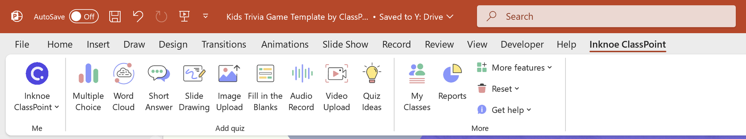
Where to set up
Find the Inknoe ClassPoint tab on your PowerPoint ribbon
ClassPoint quiz buttons
www.classpoint.io

Slide 6
Play the
template
Enter slide show mode
1
Students join at classpoint.app on any browser
2
Run the questions in slide show with your audience joined in your session!
Ask them to log in using your class code
3
www.classpoint.io

Slide 7
What's inside this template
Math Maze
Annotate the path live with the pen tools and pick students at random
Slide 9
Distance-time graph
Students plot the graph on their own devices with Slide Drawing
Slide 10
Trapezium check
A quick Multiple Choice exit ticket (the AI quiz generator can make more)
Slides 11-12
The Amazing Math Relay
Teams solve step by step for stars on the leaderboard
Slide 13
Percentage drill
A Multiple Choice question you can mark automatically with Quiz Mode
Slide 14
www.classpoint.io

Slide 8

Let's get started!
5 quick checks, live in PowerPoint
www.classpoint.io

Slide 9



Math Maze
Addition of Decimal Numbers
Add the following decimals and use your answers as guide to the end of the maze.
START
34.567
+ 35.271
46.305
+ 7.982
53.207
Jail
69.838
(You are trapped)
69.738
54.207
74.963
54.287
39.813
8.426
+ 24.537
69.242
25.5
+ 43.742
36.813
53.396
+ 83.527
32.963
28.653
64.842
136.923
59.668
Jail
53.841
+ 6.393
52.93
+ 6.738
9.234
58.660
(You are trapped)
90.634
59.134
60.234
59.634
12.660
74.242
+ 16.392
80.534
23.56
+ 44.847
68.407
You Win!

Slide 10
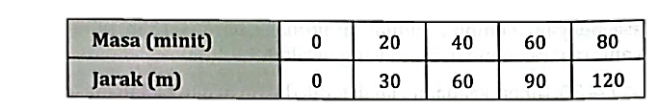


Distance (m)
Distance (m)
Time (min)
120
90
60
30
Time (min)
0
20
40
60
80

Slide 11

I have one pair of parallel sides. My co-interior angles
sum to 180°.
Trapezium

Slide 12



What is the defining property of a trapezium?
Having three pairs of parallel sides
Having one pair of parallel sides
Having equal side lengths
Having right angles
Correct answer: B

Slide 13
The Amazing Math Relay
Solve for x: 2x+5=17
Find the slope of the line: y=3x+1y=3x+1
Calculate the value of tan θ for a right-angled triangle with opposite side 3 cm and adjacent side 4 cm.
Find the area of a triangle with base 5 cm and height 3 cm.

Slide 14





Question 1
A wildlife reserve has a population of 120 rhinoceroses. If the population increases by 15% each year, how many rhinoceroses will there be at the end of two years?
A.
138
159
A.
C.
A.
156
172
B.
D.

Slide 15

Template created by ClassPoint
Connect with Us
Facebook
YouTube
Twitter
Pinterest
Instagram
TikTok
Try ClassPoint
for Free
LinkedIn
support@inknoe.com
www.classpoint.io

Slide 16
Instructions for use
In order to use this template, you must credit by keeping the previous acknowledgement slide.
You have the permission to:
Modify this template.
Utilise it for personal and commercial use.
You are not permitted to:
Provide ClassPoint templates (or modified adaptations of ClassPoint templates) for downloading.
Sub-license, sell or rent any portion of ClassPoint template (or an adapted rendition of ClassPoint template).
Obtain the copyright of ClassPoint temlplates.
Try ClassPoint
for Free

