Slide 1








Powerpoint Trivia Template:
A QUIZ SHOWDOWN

Slide 2

Overview
Easy Round: 5 General Questions = 1 point each
Intermediate Round: 4 General Questions + 1 Bonus Question = 1 point each
Difficult Round: 5 General Questions = 2 points each
LeaderBoard
Other themes you can use

Slide 3
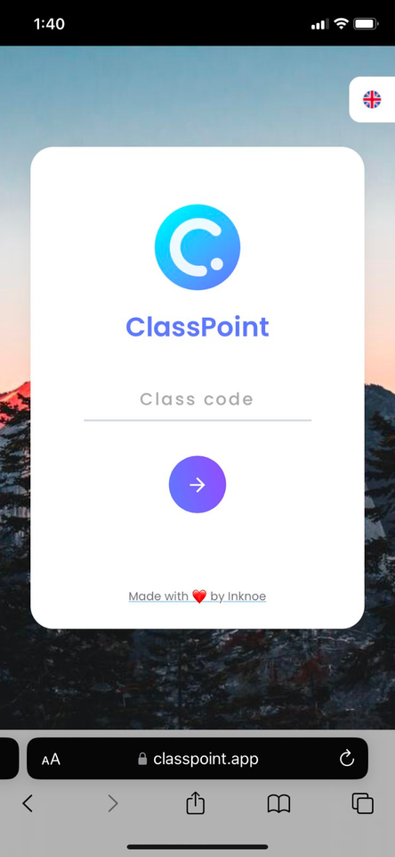
How to use this template with ClassPoint
on Participant's view
Join on ClassPoint App
  On your device's browser, go to: ClassPoint.app
  Type your Class Code and Name
  Enter the session and enjoy playing!

Slide 4
Game Rules
Individual Player
Team Players
  Each round consists of 5 questions, worth 1 point each. The difficult round is worth 2 points.
  Participants have 15 seconds to answer each question on their device.
  In case of a tied score, a bonus question will be given, and the fastest correct answer determines the winner.
  The team must have 5 members, with each member taking turns to answer questions. One representative from the team will answer each question.
  Each question in Rounds 1 and 2 is worth 1 point, while Round 3 (the difficult round) is worth 2 points.
  In the case of a tied score, a bonus question will be given. Each group must choose a representative to answer, and the fastest correct answer determines the winner.

Slide 5

EASY ROUND
Round 1

Slide 6


Which country belongs to the Asia continent?
A. Portugal
C. Panama
B. Philippines
D. Peru

Slide 7
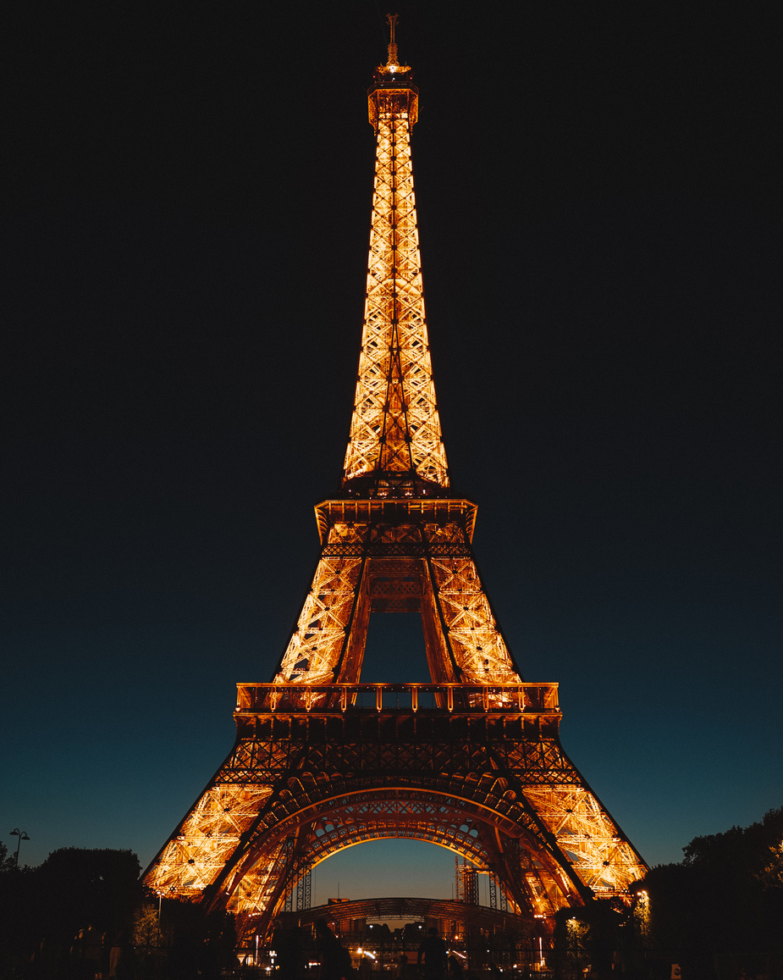
What is this image?
A. Eiffel Tower
B. Taj Mahal
C. Tower of Pisa
D. Colosseum

Slide 8
What is the smallest planet in the Solar System?
A. Jupiter
C. Earth
B. Venus
D. Mercury

Slide 9

What is the name of the World's Largest Ocean?

Slide 10
Name the 3 colors of the Ireland flag

Slide 11



Round 2
INTERMEDIATE ROUND

Slide 12



Which is the correct animated drawing of Tom's eyes in Tom & Jerry?
A. Picture 1
B. Picture 2

Slide 13
TRUE or FALSE: A dog named Laika was the first animal that went into space.
A: TRUE
B: FALSE

Slide 14






Bonus Question: Pick a color that resonates with you now.

Slide 15
What does "www" stands for in a website browser?

Slide 16
Which of these words is closest in meaning to the word: SIMULATE?
A. Excite
C. Trick
B. Imitate
D. Apelike

Slide 17

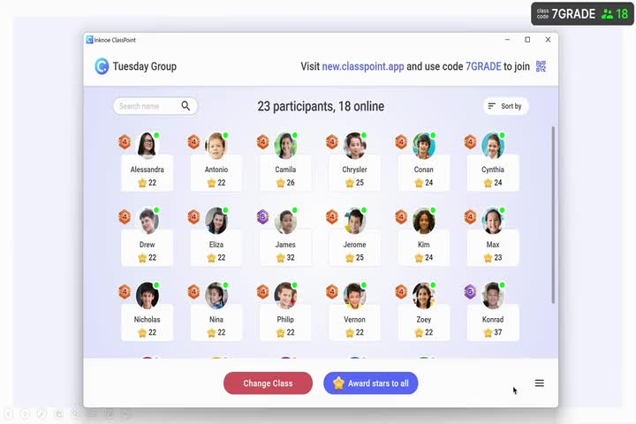

Leaderboard
How to reveal
leaderboard

Slide 18





pts!
Round 3
DIFFICULT ROUND

Slide 19
Answer the Riddle: What goes up but never comes down?

Slide 20
How can a person go 25 days without sleep?

Slide 21
What is the correct color order of the Google brand logo?
A. blue, orange, yellow, blue, green
B. blue, red, green, yellow, blue, red
C. blue, red, yellow, blue, green, red

Slide 22
What is the collective noun for BEARS?
A. Goldilocks
C. Herd
B. Sloths
D. Bear

Slide 23
What country is responsible for creating the Olympic Games?

Slide 24

TIE-BREAKER ROUND

Slide 25
Name 3 countries that starts with letter "J"

Slide 26
ANSWER SLIDE
ROUND 1 - EASY ROUND
  B. Philippines
  A. Eiffel Tower
  D. Mercury
  Pacific Ocean
  Green, White, Orange
ROUND 2 - INTERMEDIATE ROUND
  A. Picture 1
  True
  No Answer - Bonus Question
  World Wide Web
  B. Imitate
ROUND 3 - DIFFICULT ROUND
  Age
  They sleep at night
  Blue, red, yellow, blue, green, red
  B. Sloths
  Greece
TIE-BREAKER
  Jamaica, Japan, Jordan

Slide 27
Leaderboard
How to reveal
leaderboard

